Slide 1

ITA0506-COMPUTER VISION
Intelligent Traffic Sign Detection and Recognition using YOLOv8 and CNN with Driver Alert System
Guided by
Dr.R.C.Jeni Gracia
Presented by
G.D.S.P.Santosh Raja (192425064)
T.V.Sai Jagadeesh(192472146)
C.Chandu (192472332)
Y.Sravan Kumar (192472289)
B.Rakesh (192425241)
Y.Tejanvesh Reddy(192425156)

Slide 2


AGENDA
Introduction to traffic sign recognition system
Review of existing methods
Problem Statement
Objectives of the project
System Architecture
Module-wise explanation
Result and Discussion
Implementation
Application
Conclusion
And References

Slide 3
INTRODUCTION
Traffic signs are essential for maintaining road safety and guiding drivers.
In real-world situations, drivers may miss signs due to fatigue, distractions, or poor visibility.
Missing important signs like speed limits or stop signs can lead to accidents.
To solve this problem, intelligent systems are developed using Artificial Intelligence.
This system uses YOLOv8 for detection and CNN for classification.
It can automatically detect traffic signs from live video and recognize their meaning.

Slide 4
LL LITERATURE REVIEW
Title | Authors & Year | Technologies Used | Research Gaps Identified
Traffic Sign Detection using Traditional Computer Vision Techniques | A. Sharma et al. (2024) | Image Processing, SVM, HOG | Low accuracy in complex environments and poor performance in real-time
Real-Time Traffic Sign Detection using Deep Learning | B. Lee et al. (2023) | CNN, OpenCV, Deep Learning | Limited speed optimization for real-time applications
Traffic Sign Recognition using YOLO-based Model | C. Wang et al. (2024) | YOLOv5, Object Detection | Difficulty in detecting small and multiple signs simultaneously
Traffic Sign Detection with Object Tracking Systems | D. Kumar et al. (2023) | YOLO, Deep SORT, Kalman Filter | Lack of efficient temporal analysis and tracking consistency
Advanced Traffic Sign Recognition using YOLOv8 and Deep Learning | F. John et al. (2025) | YOLOv8, CNN | Still lacks fully optimized real-time deployment and robustness in all weather conditions

Slide 5

PROBLEM STATEMENT
Drivers may miss traffic signs due to bad weather, low visibility, or lack of attention.
Existing systems are often slow and not suitable for real-time detection.
They struggle to detect multiple traffic signs at the same time.
Many systems do not track signs continuously across video frames. There is a need for a system that can detect, track, recognize signs, and alert the driver instantly.

Slide 6
OBJECTIVES
To develop a real-time traffic sign detection system .
To use YOLOv8 for fast and accurate object detection and classify traffic signs using CNN or transfer learning.
To track multiple objects across frames and extract relevant regions for better processing.
To provide real-time alerts to drivers To improve overall road safety.

Slide 7
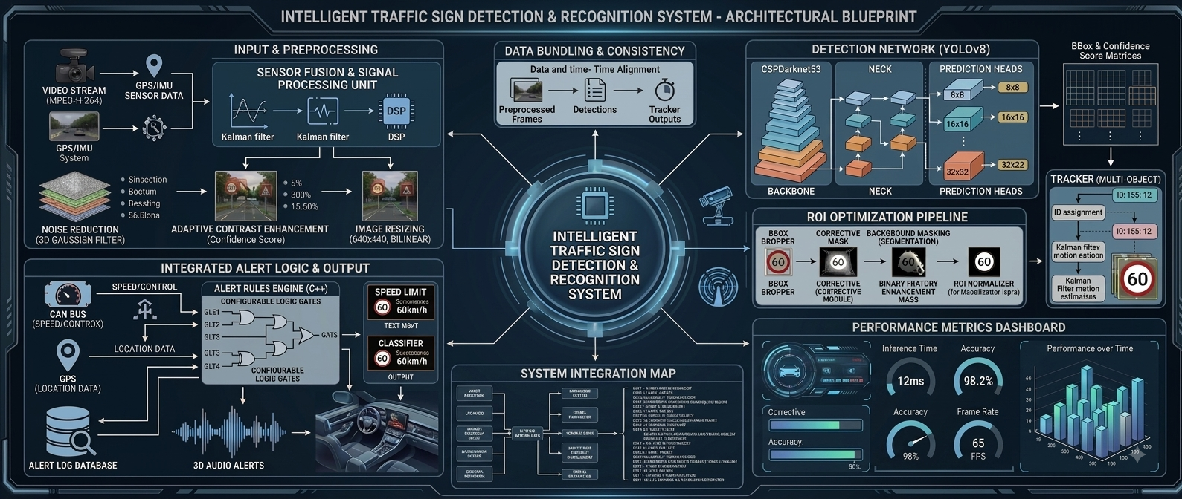
_{Architecture}

Slide 8


Module 1: Intelligent Video Acquisition & Adaptive Preprocessing
The system first captures real-time road video using a camera or webcam.
The video is divided into individual frames so that each frame can be processed separately.
OpenCV is used for basic image processing such as resizing, normalization, and noise reduction.
Brightness and contrast can be adjusted to improve visibility under different lighting conditions.
The preprocessed frames are then given as input to the YOLOv8 detection model.
Techniques Used
OpenCV
Frame extraction
Image resizing

Slide 9
Module-2 Real-Time Traffic Sign Detection using YOLOv8
YOLOv8 is used to locate traffic signs in each video frame.
It identifies the sign and creates a bounding box around it.
The model also provides a confidence score that indicates how confident it is about the detection.
YOLOv8 can detect multiple traffic signs in the same frame.
Since YOLOv8 performs detection quickly, it is suitable for real-time traffic applications.
Techniques / Methodology:
Input preprocessed frame.
YOLOv8 processes the complete image.
Features are extracted by the neural network.

Slide 10
Module 3: Multi-Object Tracking & Temporal Analysis
After detection, the system continuously follows traffic signs across different video frames.
Tracking helps the system understand whether the sign in the current frame is the same sign detected in the previous frame.
A unique tracking ID can be assigned to every detected sign.
This reduces repeated processing and provides more stable results.
Temporal information from consecutive frames can also be used to improve the reliability of detection.
Techniques / Methodology:
Object tracking
Kalman Filter
SORT / Deep SORT
Frame-to-frame tracking.

Slide 11
Module 4: Region Extraction & Feature Optimization
Once YOLOv8 detects a sign, only the traffic sign region is extracted from the frame.
This extracted area is called the Region of Interest (ROI).
Removing unnecessary background helps the CNN concentrate on the actual sign.
The ROI is resized and normalized before being given to the classification model.
This process improves the quality of features used for recognizing the sign.
Techniques / Methodology:
Bounding-box based ROI extraction
Image cropping
Resizing
Normalization
Feature optimization

Slide 12
Module 5: Traffic Sign Classification using CNN
CNN is used to determine what type of traffic sign has been detected.
The extracted traffic sign image is given as input to the CNN.
CNN automatically learns important features such as edges, shapes, colors, and patterns.
The final layer predicts the most likely traffic sign category.
Transfer learning can be used with models such as MobileNet or ResNet to improve performance with less training time.
Techniques / Methodology:
Input: Takes the detected traffic sign image.
Feature Extraction: Identifies shapes, colors, and patterns.
Classification: CNN determines the type of traffic sign.
Prediction: Softmax selects the class with the highest probability.

Slide 13
Module 6: Driver Alert & Decision Support System
After the traffic sign is classified, the result is sent to the driver alert system.
The system converts the detected sign into an easy-to-understand warning.
A visual message can be displayed on the screen.
An audio warning can also be generated using a Text-to-Speech system.
Tracking information can help prevent the same alert from being repeatedly generated.
Techniques / Methodology:
Visual notification
Alert triggering
Event-based decision logic

Slide 14
Results and Discussion
Traditional image-processing methods provide lower accuracy because they depend heavily on manually designed features.
CNN-based methods improve recognition by automatically learning image features.
YOLOv8-based methods provide better real-time detection performance.
The proposed YOLOv8 + CNN approach combines fast detection with detailed classification.
Tracking and driver alerts further improve the practical usefulness of the system.

Slide 15
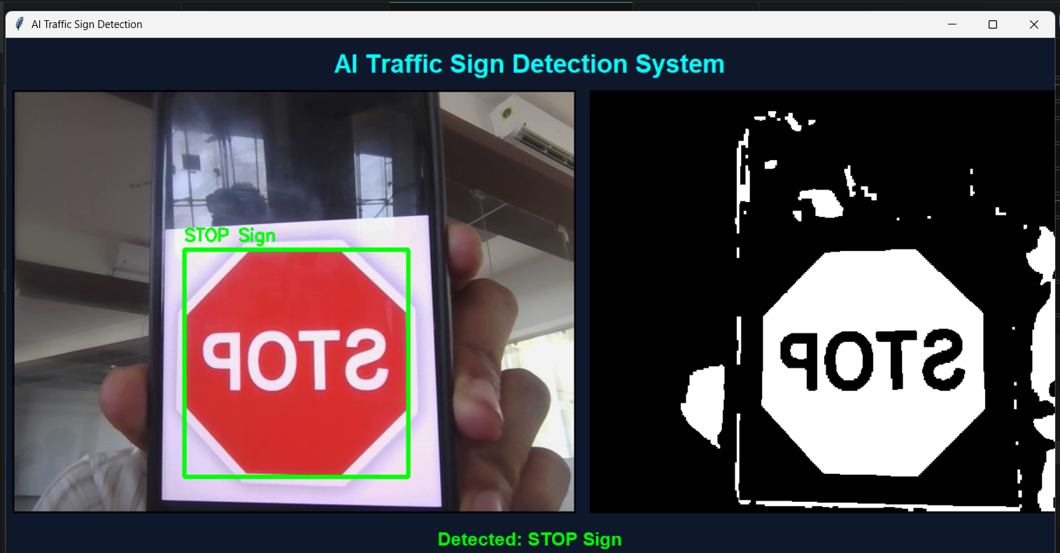
Implementation

Slide 16
Applications
Advanced Driver Assistance Systems (ADAS): Helps drivers identify important traffic signs while driving.
Autonomous Vehicles: Provides traffic sign information to automated driving systems.
Smart Transportation: Can be integrated into intelligent transportation systems.
Road Safety Monitoring: Helps monitor and recognize signs from road cameras.
Driver Assistance Applications: Provides real-time warnings about speed limits, stop signs, and other important signs.
Vehicle Navigation Systems: Recognized signs can be combined with navigation information to provide better driving assistance.

Slide 17
Conclusion
The proposed system provides an AI-based solution for real-time traffic sign detection and recognition.
YOLOv8 is used to quickly detect traffic signs from road video.
Object tracking maintains the identity of signs across multiple frames.
ROI extraction focuses the classification process on the detected traffic sign.
CNN or transfer learning is used to accurately recognize the type of traffic sign.
The driver alert system provides visual and audio warnings to improve driver awareness.
Overall, the combination of YOLOv8 + Tracking + CNN + Driver Alert provides a practical approach for intelligent and safer driving assistance.

Slide 18
References
Stallkamp, J., Schlipsing, M., Salmen, J., & Igel, C. (2024)Man vs. Computer: Benchmarking Machine Learning Algorithms for Traffic Sign Recognition.
Houben, S., Stallkamp, J., Salmen, J., Schlipsing, M., & Igel, C. (2025)Detection of Traffic Signs in Real-World Images: The German Traffic Sign Detection Benchmark.
Zhu, Z., Liang, D., Zhang, S., Huang, X., Li, B., & Hu, S. (2023)Traffic-Sign Detection and Classification in the Wild.
Wojke, N., Bewley, A., & Paulus, D. (2024)Simple Online and Realtime Tracking with a Deep Association Metric.
Gong, C., Li, A., Song, Y., Xu, N., & He, W. (2023)Traffic Sign Recognition Based on the YOLOv3 Algorithm.
Xing, W., & Huang, H. (2024)Traffic Sign Detection Algorithm Based on Improved YOLOv5.

Slide 19
THANK YOU

